Slide 1
패키지 설정하기

Slide 2
순서
패키지 문서 작성
스프링 프로젝트 생성 및 설정
XML 일부 설정
패키지 만들기

Slide 3
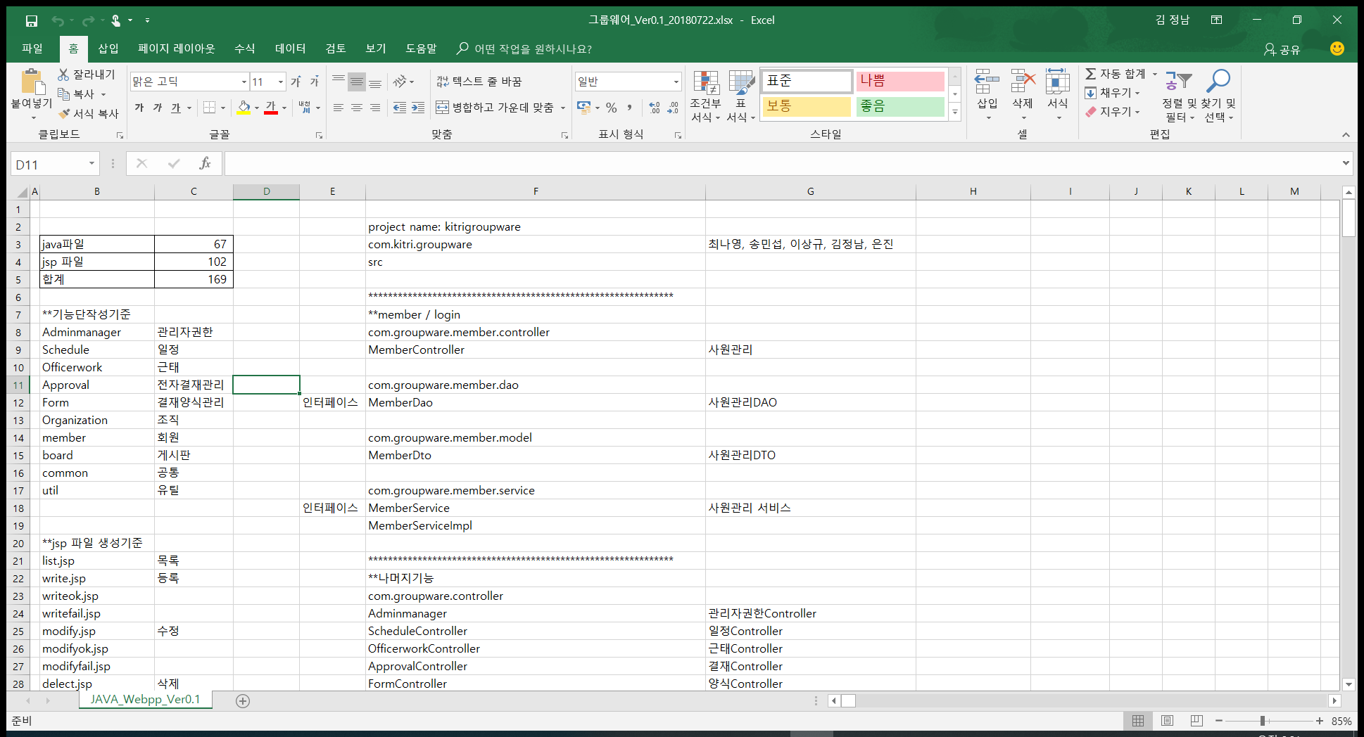
패키지 문서 작성

Slide 4
SPRING 프로젝트 생성 및 설정
SPRING 프로젝트 생성 및 설정 PPT 참조(메이븐 설정 포함)

Slide 5
XML 일부 설정
SPRING 프로젝트 생성 및 설정 PPT 참조

Slide 6
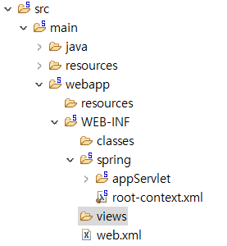
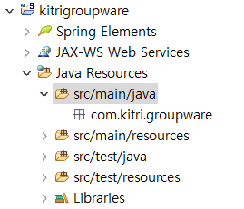
패키지 만들기
Java 소스
resources
VIEWS 이외의 모든것
Views
Jsp 전체

Slide 7
root-context.xml - @Autowired 연동
<!-- @Autowired 와 연동되어 있다-->
<context:component-scan base-package="com. groupware.**.service"/>
<!-- ** >> 사이에 몇개있어도 상관없음 / * 이면 패키지 아래 하나 -->

Slide 8
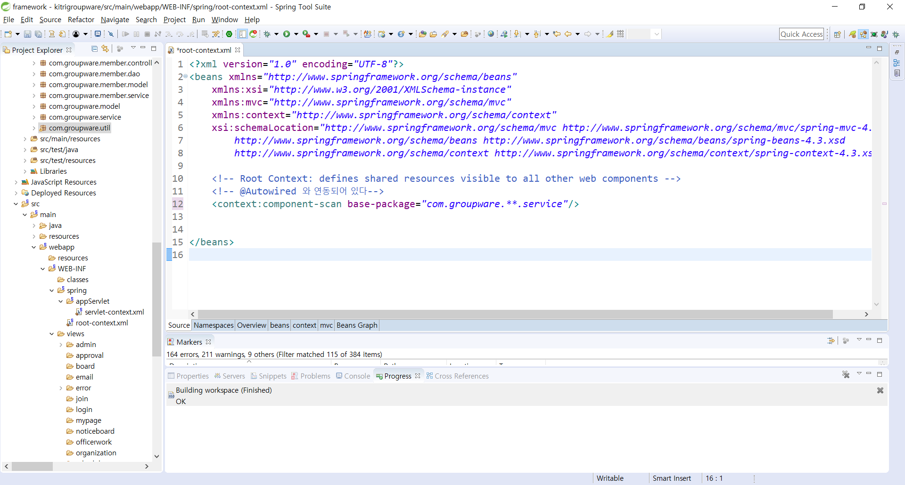

Slide 9
root-context.xml 설정 – mybatis 연결
<!-- 데이터 소스 / 마이바티스에 연결 정보 넘겨주는건 스프링이 함 -->
<!-- Root Context: defines shared resources visible to all other web components -->
<bean id="ds" class="org.springframework.jdbc.datasource.SimpleDriverDataSource">
<property name="driverClass" value="oracle.jdbc.driver.OracleDriver"/>
<property name="url" value="jdbc:oracle:thin:@127.0.0.1:1521:xe"/>
<property name="username" value="GROUPWARE"/>
<property name="password" value="GROUPWARE"/>
</bean>

Slide 10
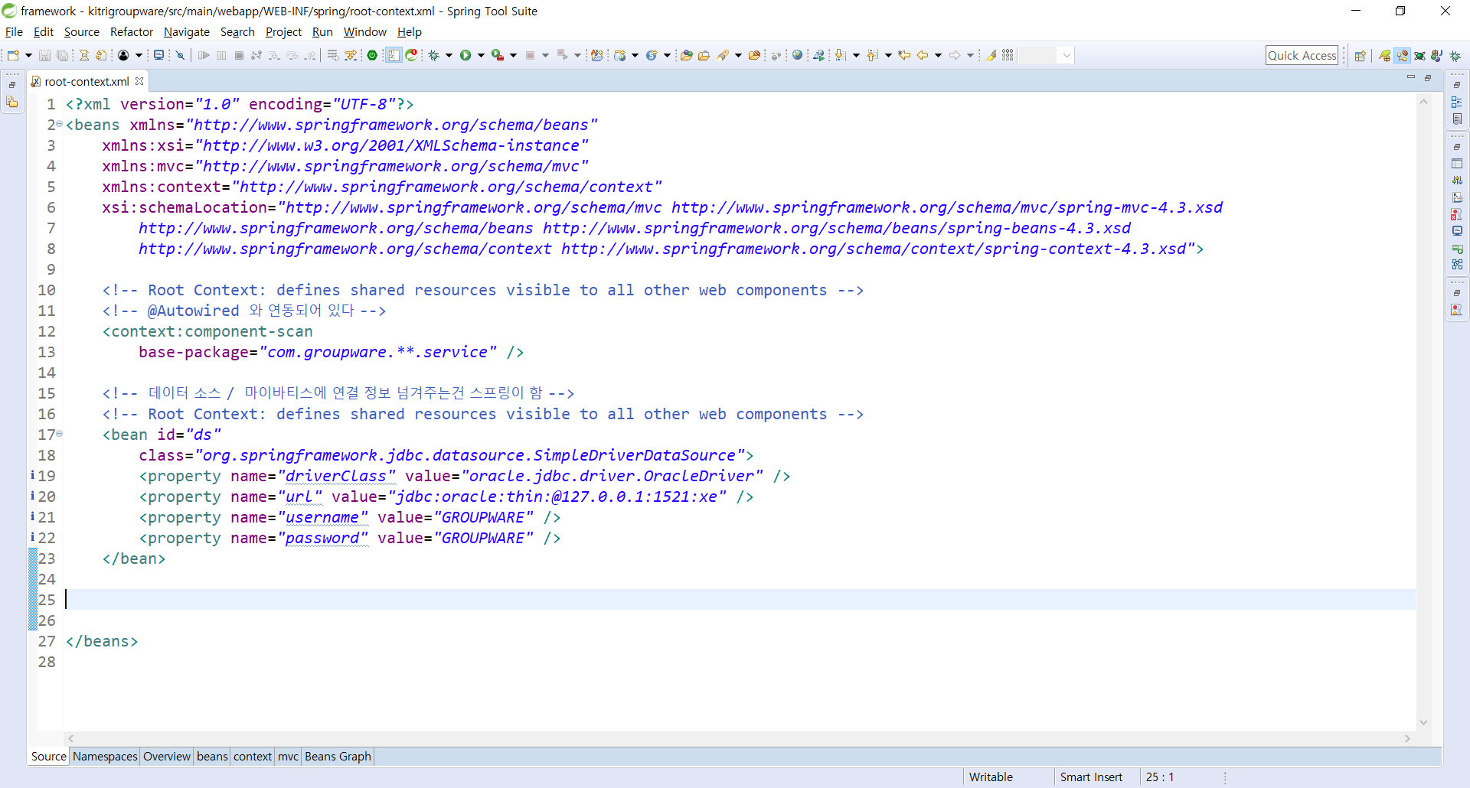

Slide 11
root-context.xml 설정 – sqlsession연결
<!-- sqlsession 탬플릿 -->
<bean id="ss" class="org.mybatis.spring.SqlSessionTemplate">
<constructor-arg ref="ssfb"/>
</bean>

Slide 12
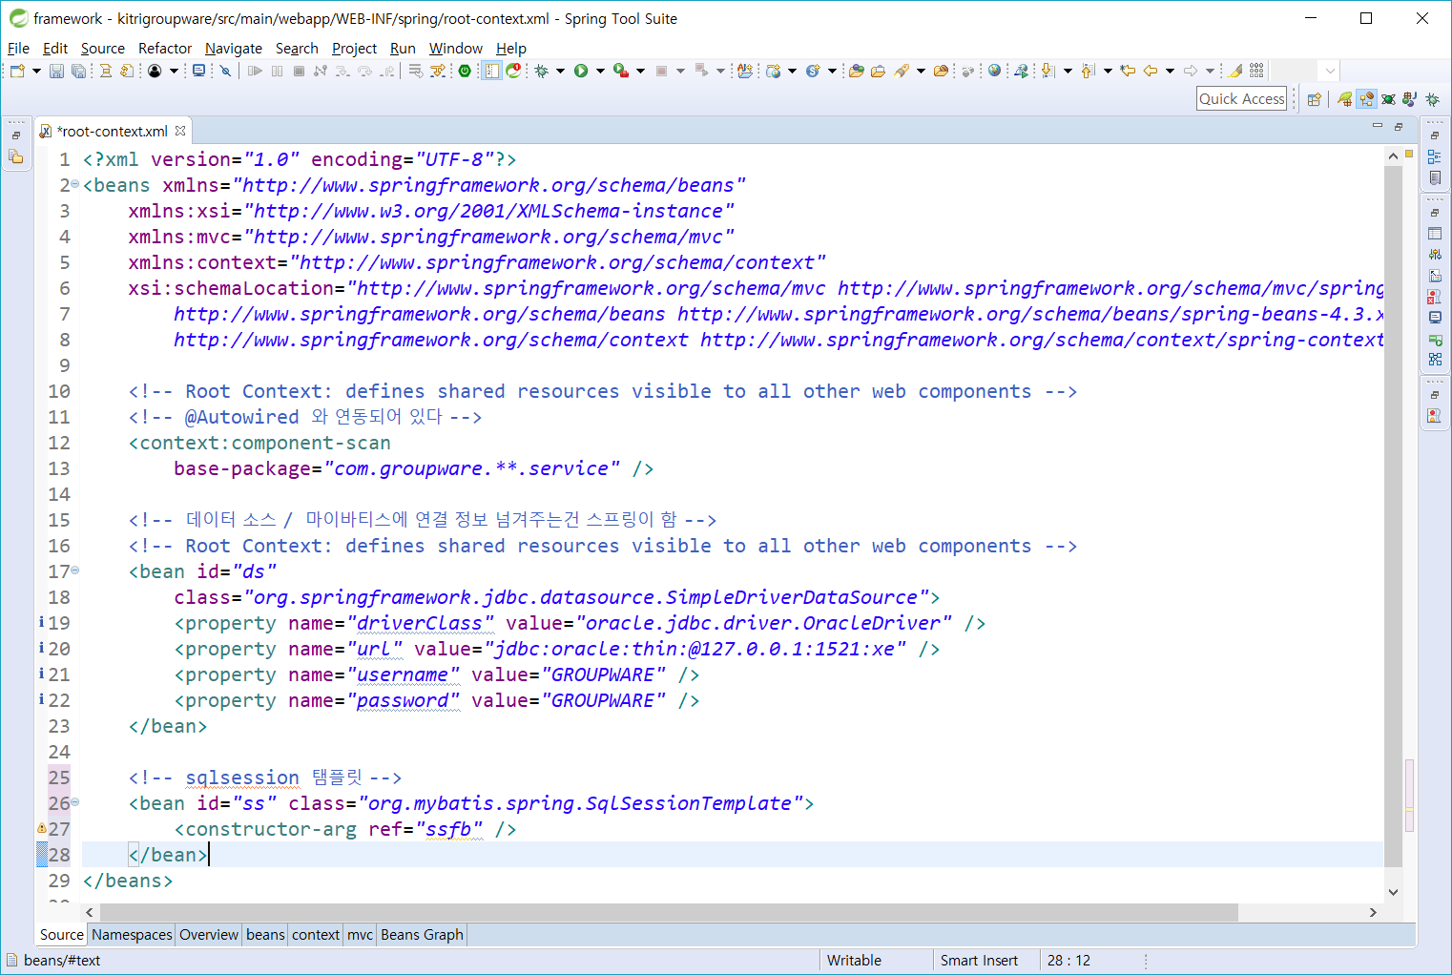

Slide 13
root-context.xml 설정 – 패토리빈 연동
<!-- 팩토리 빈 설정 파일 만들기 / 위치 알려줌 -->
<bean id="ssfb" class="org.mybatis.spring.SqlSessionFactoryBean">
<property name="dataSource" ref="ds" />
<property name="configLocation"value="classpath:com/groupware/config/mybatis/Configuration.xml" />
<property name="mapperLocations">
<list>
<value>classpath:com/groupware/config/mybatis/adminmanager.xml</value>
<value>classpath:com/groupware/config/mybatis/approval.xml</value>
<value>classpath:com/groupware/config/mybatis/board_admin.xml</value>
<value>classpath:com/groupware/config/mybatis/board_common.xml</value>
<value>classpath:com/groupware/config/mybatis/board.xml</value>
<value>classpath:com/groupware/config/mybatis/form.xml</value>
<value>classpath:com/groupware/config/mybatis/login.xml</value>
<value>classpath:com/groupware/config/mybatis/membermanager.xml</value>
<value>classpath:com/groupware/config/mybatis/noticeboard_admin.xml</value>
<value>classpath:com/groupware/config/mybatis/noticeboard_common.xml</value>
<value>classpath:com/groupware/config/mybatis/noticeboard.xml</value>
<value>classpath:com/groupware/config/mybatis/officerwork.xml</value>
<value>classpath:com/groupware/config/mybatis/organization.xml</value>
<value>classpath:com/groupware/config/mybatis/schedule.xml</value>
</list>
</property>
</bean>

Slide 14
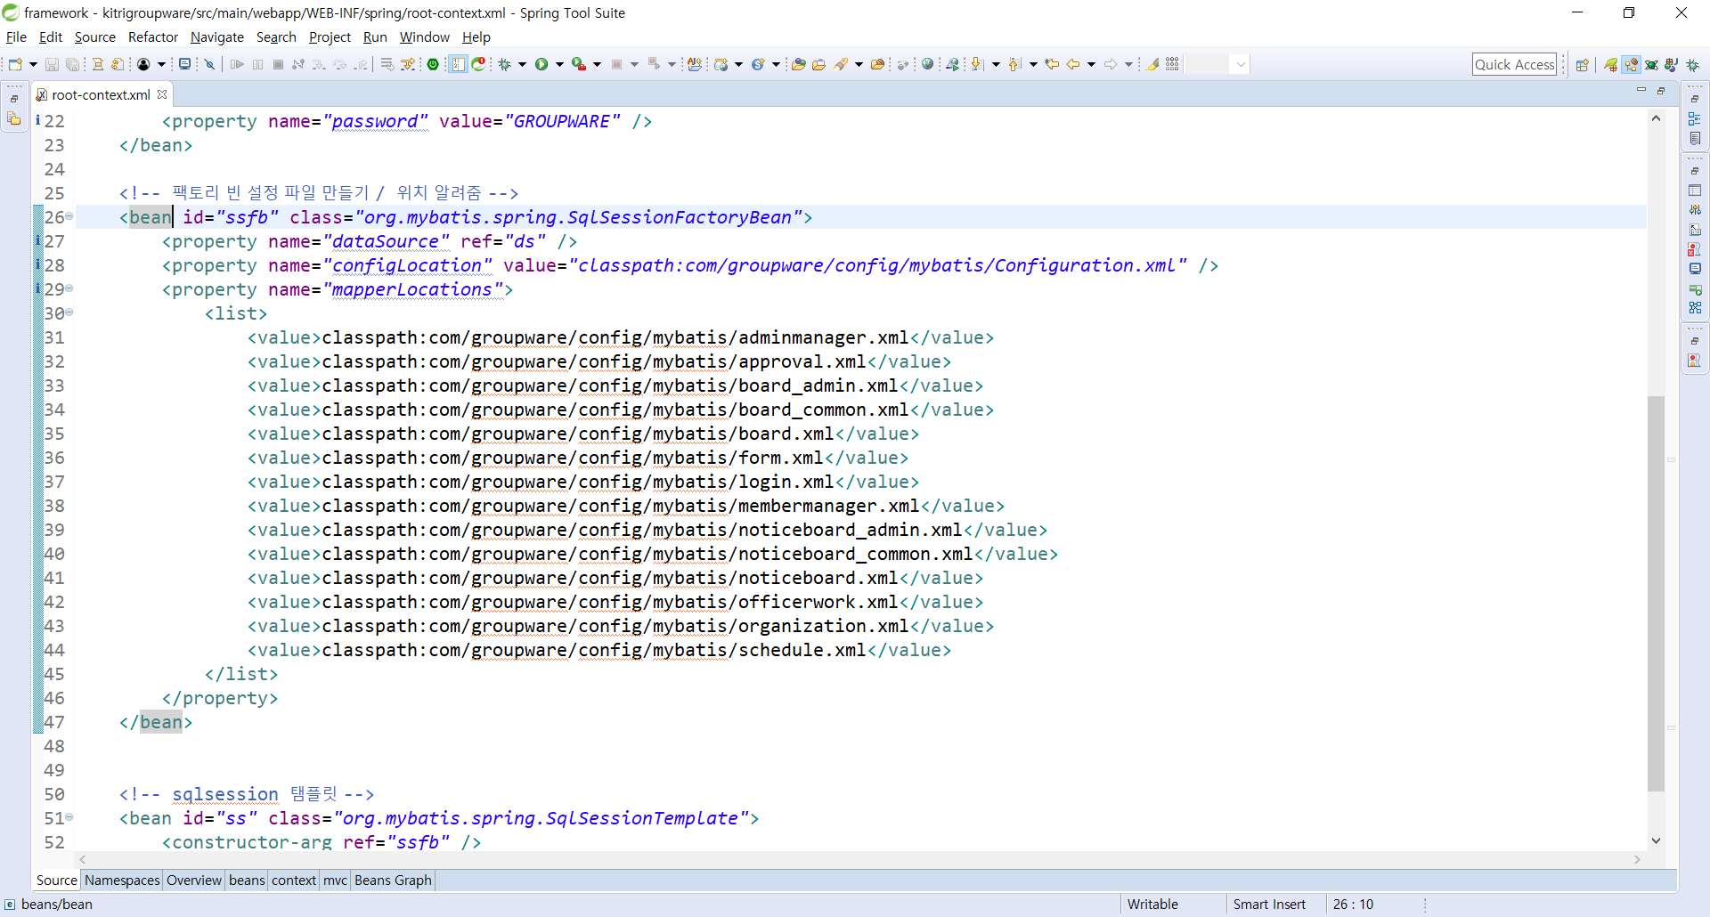

Slide 15
root-context.xml 설정
<?xml version="1.0" encoding="UTF-8"?>
<beans xmlns="http://www.springframework.org/schema/beans"
xmlns:xsi="http://www.w3.org/2001/XMLSchema-instance"
xmlns:mvc="http://www.springframework.org/schema/mvc"
xmlns:context="http://www.springframework.org/schema/context"
xsi:schemaLocation="http://www.springframework.org/schema/mvc http://www.springframework.org/schema/mvc/spring-mvc-4.3.xsd
http://www.springframework.org/schema/beans http://www.springframework.org/schema/beans/spring-beans-4.3.xsd
http://www.springframework.org/schema/context http://www.springframework.org/schema/context/spring-context-4.3.xsd">
<!-- Root Context: defines shared resources visible to all other web components -->
<!-- @Autowired 와 연동되어 있다 -->
<context:component-scan
base-package="com.groupware.**.service" />
<!-- 데이터 소스 / 마이바티스에 연결 정보 넘겨주는건 스프링이 함 -->
<!-- Root Context: defines shared resources visible to all other web components -->
<bean id="ds"
class="org.springframework.jdbc.datasource.SimpleDriverDataSource">
<property name="driverClass" value="oracle.jdbc.driver.OracleDriver" />
<property name="url" value="jdbc:oracle:thin:@127.0.0.1:1521:xe" />
<property name="username" value="GROUPWARE" />
<property name="password" value="GROUPWARE" />
</bean>
<!-- 팩토리 빈 설정 파일 만들기 / 위치 알려줌 -->
<bean id="ssfb" class="org.mybatis.spring.SqlSessionFactoryBean">
<property name="dataSource" ref="ds" />
<property name="configLocation"value="classpath:com/groupware/config/mybatis/Configuration.xml" />
<property name="mapperLocations">
<list>
<value>classpath:com/groupware/config/mybatis/adminmanager.xml</value>
<value>classpath:com/groupware/config/mybatis/approval.xml</value>
<value>classpath:com/groupware/config/mybatis/board_admin.xml</value>
<value>classpath:com/groupware/config/mybatis/board_common.xml</value>
<value>classpath:com/groupware/config/mybatis/board.xml</value>
<value>classpath:com/groupware/config/mybatis/form.xml</value>
<value>classpath:com/groupware/config/mybatis/login.xml</value>
<value>classpath:com/groupware/config/mybatis/membermanager.xml</value>
<value>classpath:com/groupware/config/mybatis/noticeboard_admin.xml</value>
<value>classpath:com/groupware/config/mybatis/noticeboard_common.xml</value>
<value>classpath:com/groupware/config/mybatis/noticeboard.xml</value>
<value>classpath:com/groupware/config/mybatis/officerwork.xml</value>
<value>classpath:com/groupware/config/mybatis/organization.xml</value>
<value>classpath:com/groupware/config/mybatis/schedule.xml</value>
</list>
</property>
</bean>
<!-- sqlsession 탬플릿 -->
<bean id="ss" class="org.mybatis.spring.SqlSessionTemplate">
<constructor-arg ref="ssfb" />
</bean>
</beans>

Slide 16
servlet-context.xml 설정
<!-- ajax 설정 -->
<mvc:annotation-driven>
<!-- messageConvertert -->
<mvc:message-converters>
<beans:bean class="org.springframework.http.converter.StringHttpMessageConverter">
<beans:property name="supportedMediaTypes">
<beans:list>
<beans:value>text/html; charset=UTF-8</beans:value>
<beans:value>application/json; charset=UTF-8</beans:value>
</beans:list>
</beans:property>
</beans:bean>
</mvc:message-converters>
</mvc:annotation-driven>

Slide 17
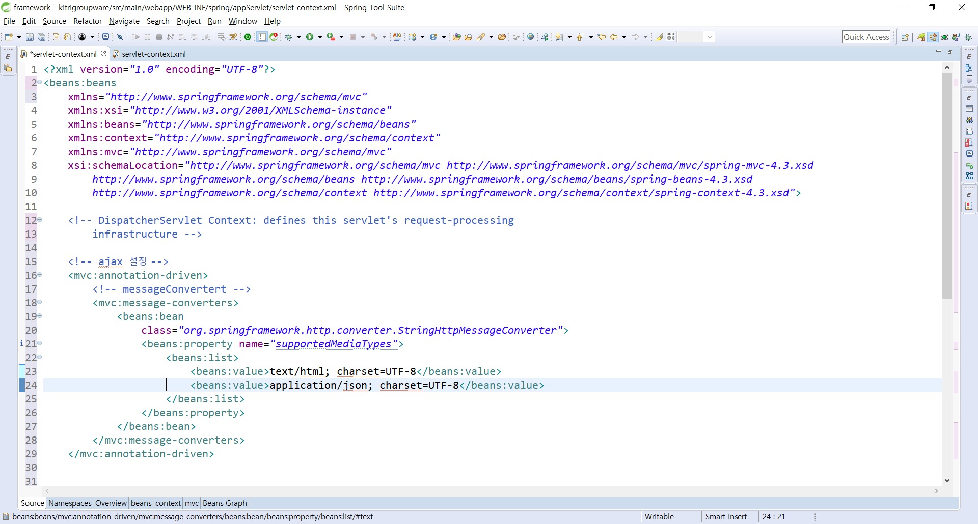

Slide 18
servlet-context.xml 설정
<!-- Enables the Spring MVC @Controller programming model -->
<!-- 여기안에다가 service 만든것을 넣어라 -->
<annotation-driven />
<context:component-scan base-package="com.groupware.**.controller"/>
<!-- ** >> 사이에 몇개있어도 상관없음 / * 이면 패키지 아래 하나 -->

Slide 19
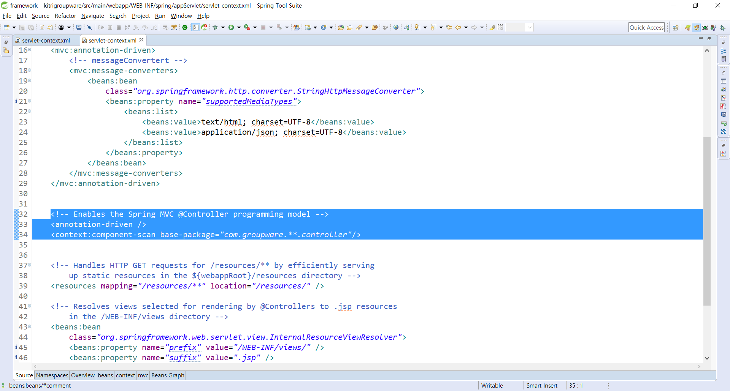

Slide 20
servlet-context.xml 설정
<!-- /resources/board/css/** >> css 만 적으면 바로 된다.-->
<mvc:resources mapping="/css/**" location="/resources/board/css/"/>
<mvc:resources mapping="/img/**" location="/resources/board/img/"/>
<mvc:resources mapping="/js/**" location="/resources/board/js/"/>

Slide 21
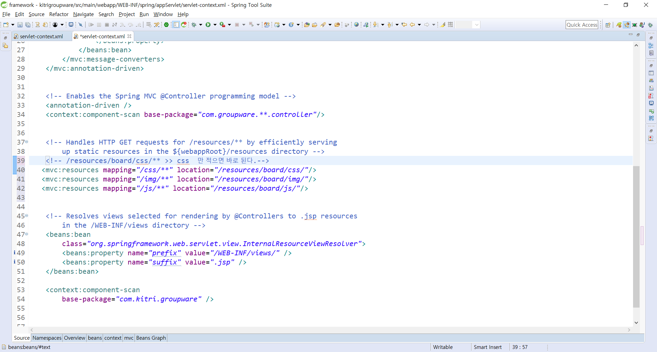

Slide 22
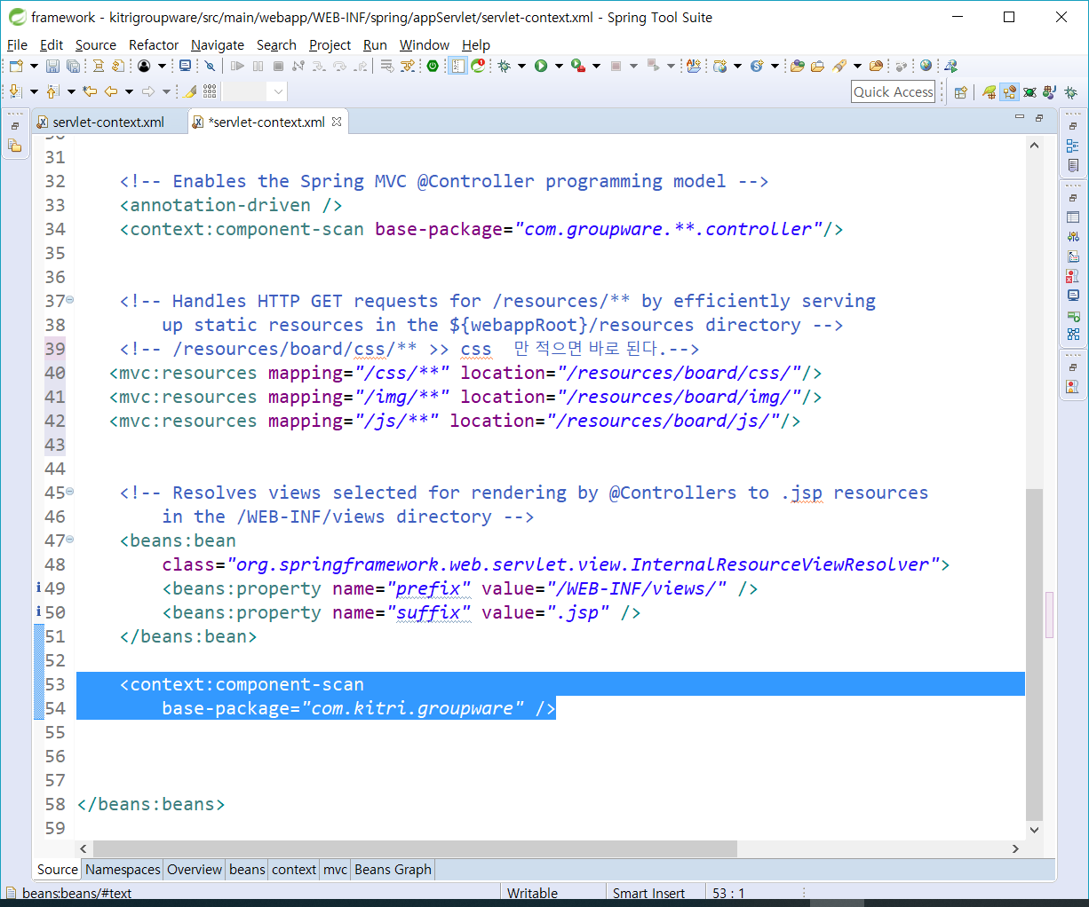
<context:component-scan base-package="com.kitri.groupware" /> 삭제

Slide 23
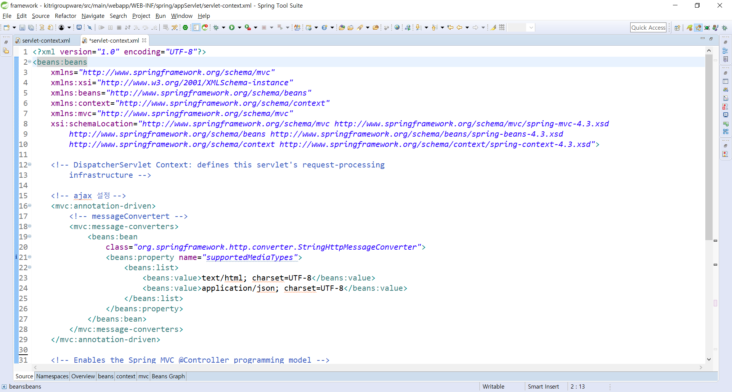

Slide 24
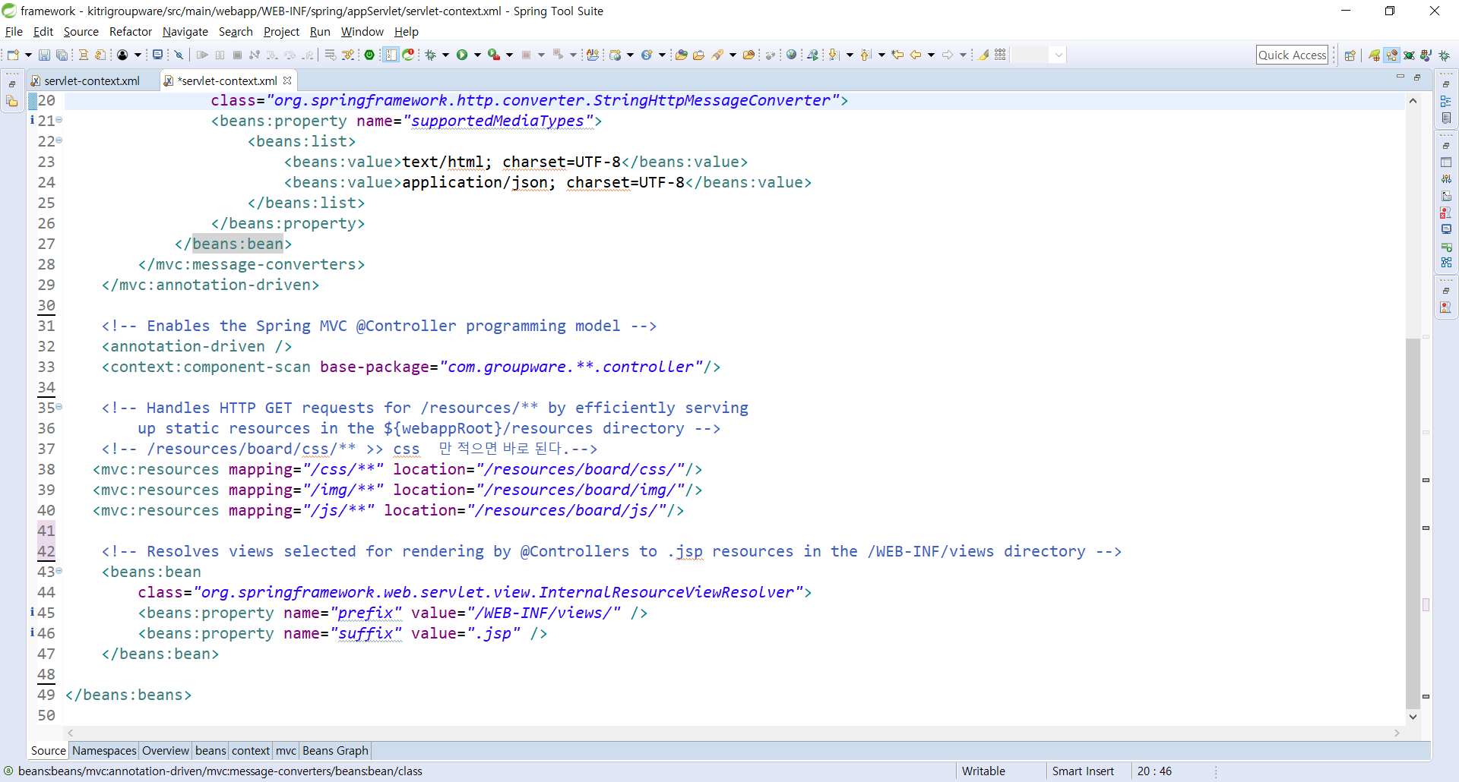

Slide 25
servlet-context.xml
<?xml version="1.0" encoding="UTF-8"?>
<beans:beans
xmlns="http://www.springframework.org/schema/mvc"
xmlns:xsi="http://www.w3.org/2001/XMLSchema-instance"
xmlns:beans="http://www.springframework.org/schema/beans"
xmlns:context="http://www.springframework.org/schema/context"
xmlns:mvc="http://www.springframework.org/schema/mvc"
xsi:schemaLocation="http://www.springframework.org/schema/mvc http://www.springframework.org/schema/mvc/spring-mvc-4.3.xsd
http://www.springframework.org/schema/beans http://www.springframework.org/schema/beans/spring-beans-4.3.xsd
http://www.springframework.org/schema/context http://www.springframework.org/schema/context/spring-context-4.3.xsd">
<!-- DispatcherServlet Context: defines this servlet's request-processing
infrastructure -->
<!-- ajax 설정 -->
<mvc:annotation-driven>
<!-- messageConvertert -->
<mvc:message-converters>
<beans:bean
class="org.springframework.http.converter.StringHttpMessageConverter">
<beans:property name="supportedMediaTypes">
<beans:list>
<beans:value>text/html; charset=UTF-8</beans:value>
<beans:value>application/json; charset=UTF-8</beans:value>
</beans:list>
</beans:property>
</beans:bean>
</mvc:message-converters>
</mvc:annotation-driven>
<!-- Enables the Spring MVC @Controller programming model -->
<annotation-driven />
<context:component-scan base-package="com.groupware.**.controller"/>
<!-- Handles HTTP GET requests for /resources/** by efficiently serving
up static resources in the ${webappRoot}/resources directory -->
<!-- /resources/board/css/** >> css 만 적으면 바로 된다.-->
<mvc:resources mapping="/css/**" location="/resources/board/css/"/>
<mvc:resources mapping="/img/**" location="/resources/board/img/"/>
<mvc:resources mapping="/js/**" location="/resources/board/js/"/>
<!-- Resolves views selected for rendering by @Controllers to .jsp resources in the /WEB-INF/views directory -->
<beans:bean
class="org.springframework.web.servlet.view.InternalResourceViewResolver">
<beans:property name="prefix" value="/WEB-INF/views/" />
<beans:property name="suffix" value=".jsp" />
</beans:bean>
</beans:beans>

Slide 26
Configuration.xml 추가
<!DOCTYPE configuration
PUBLIC "-//mybatis.org//DTD Config 3.0//EN"
"http://mybatis.org/dtd/mybatis-3-config.dtd">
<configuration>
<typeAliases>
<typeAlias alias="map" type="java.util.Map"/>
<typeAlias alias="boardDto" type="com.groupware.board.model.boardDto"/>
<typeAlias alias="noticboardDto" type=" com.groupware.board.model.noticboardDto"/>
<typeAlias alias=" MemberDto" type="com.groupware.member.model.MemberDto"/>
<typeAlias alias="AdminmanagerDto" type=" com.groupware.model.AlbumDto"/>
<typeAlias alias="ApprovalDto" type=" com.groupware.model.ApprovalDto "/>
<typeAlias alias="OfficerworkDto" type=" com.groupware.model.OfficerworkDto "/>
<typeAlias alias="OrganizationDto" type=" com.groupware.OrganizationDto"/>
<typeAlias alias="ScheduleDto" type=" com.groupware.model.ScheduleDto"/>
</typeAliases>
</configuration>

Slide 27
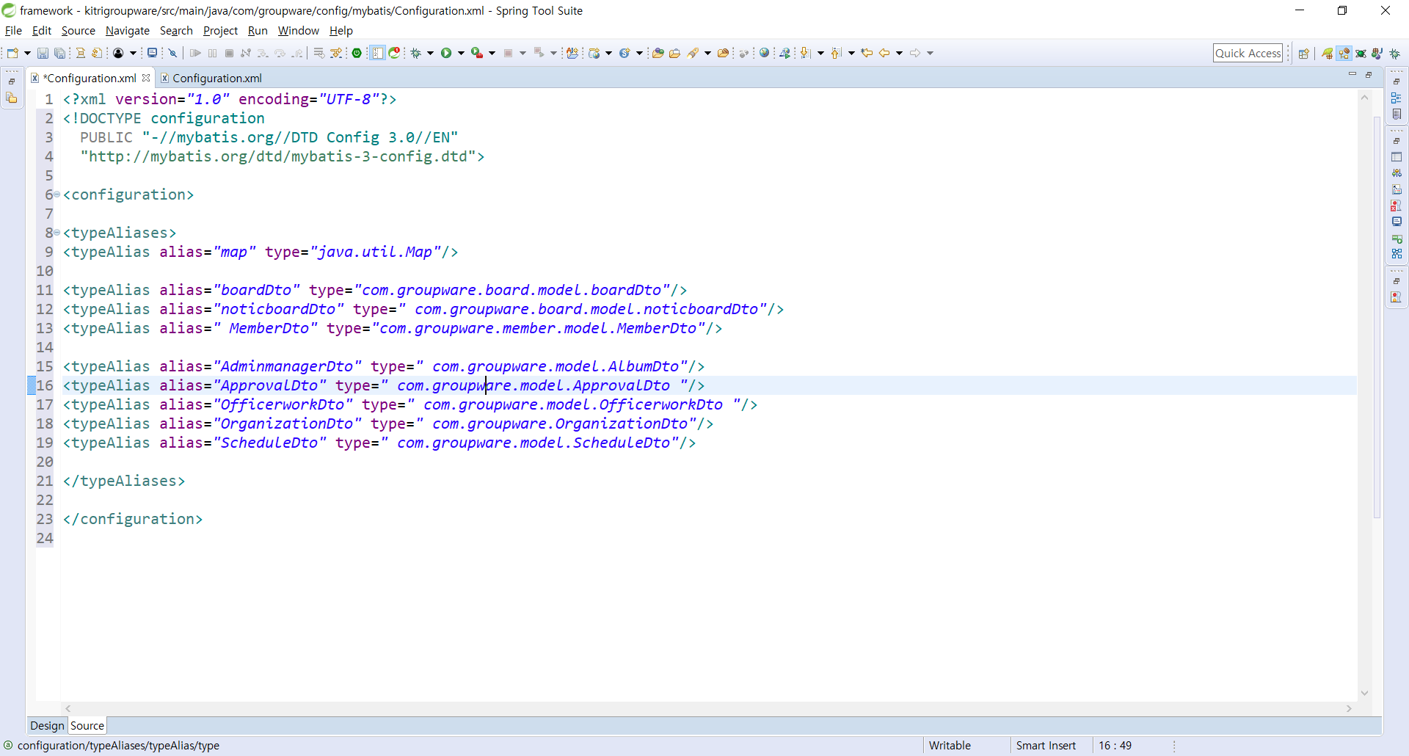
Configuration.xml 추가

Slide 28
<?xml version="1.0" encoding="UTF-8"?>
<!DOCTYPE configuration
PUBLIC "-//mybatis.org//DTD Config 3.0//EN"
"http://mybatis.org/dtd/mybatis-3-config.dtd">
<configuration>
<typeAliases>
<typeAlias alias="map" type="java.util.Map"/>
<typeAlias alias="boardDto" type="com.groupware.board.model.boardDto"/>
<typeAlias alias="noticboardDto" type=" com.groupware.board.model.noticboardDto"/>
<typeAlias alias=" MemberDto" type="com.groupware.member.model.MemberDto"/>
<typeAlias alias="AdminmanagerDto" type=" com.groupware.model.AlbumDto"/>
<typeAlias alias="ApprovalDto" type=" com.groupware.model.ApprovalDto "/>
<typeAlias alias="OfficerworkDto" type=" com.groupware.model.OfficerworkDto "/>
<typeAlias alias="OrganizationDto" type=" com.groupware.OrganizationDto"/>
<typeAlias alias="ScheduleDto" type=" com.groupware.model.ScheduleDto"/>
</typeAliases>
</configuration>

Slide 29
com.kitri.config.mybatis 추가
<!DOCTYPE mapper
PUBLIC "-//mybatis.org//DTD Mapper 3.0//EN"
"http://mybatis.org/dtd/mybatis-3-mapper.dtd">

Slide 30
adminmanager.xml
<mapper namespace="com.groupware.dao.AdminmanagerDao">
</mapper>

Slide 31
approval.xml
<mapper namespace="com.groupware.dao.ApprovalDao">
</mapper>

Slide 32
form.xml
<mapper namespace="com.groupware.dao.FormDao">
</mapper>

Slide 33
board_admin.xml
<mapper namespace="com.groupware.dao.ApprovalDao">
</mapper>

Slide 34
officerwork.xml
<mapper namespace="com.groupware.dao.OfficerworkDao">
</mapper>

Slide 35
organization.xml
<mapper namespace="com.groupware.dao.OrganizationDao">
</mapper>

Slide 36
schedule.xml
<mapper namespace="com.groupware.dao.ScheduleDao">
</mapper>

Slide 37
membermanager.xml
<mapper namespace="com.groupware.member.dao.MemberDao">
</mapper>

Slide 38
board.xml
<mapper namespace="com.groupware.board.dao.boardDAO">
</mapper>

Slide 39
noticeboard.xml
<mapper namespace="com.groupware.board.dao.noticboardDAO">
</mapper>

Slide 40
준비 완료

